Slide 1
NCI-AD: Spotlight on Social Connectedness
February 3, 2021

Slide 2
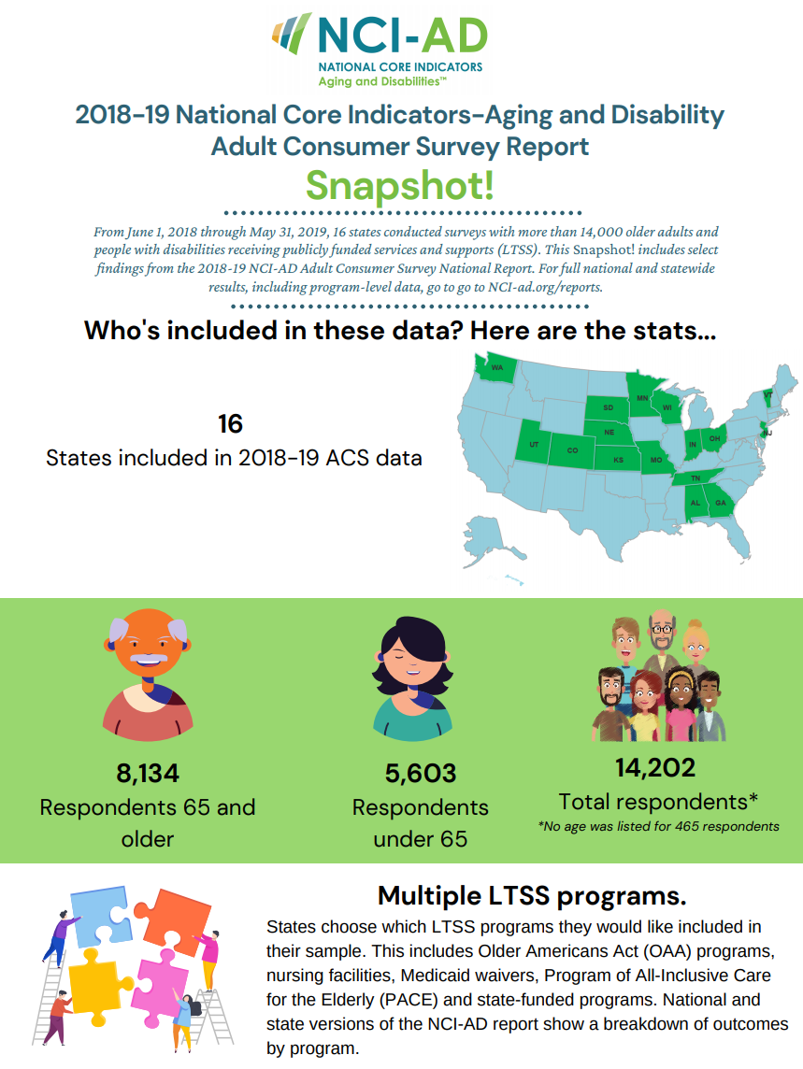
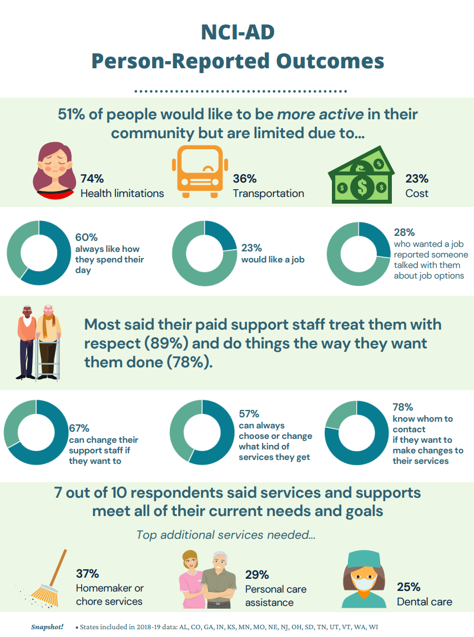
2018-19 NCI-AD Snapshot!
Notes:
But first we wanted to quickly share a new resource that was recently posted to our website
https://nci-ad.org/upload/reports/NCI-AD_Snapshot.pdf
Pulls data from the NCI-AD National Report
Improves accessibility of the data
Easy-to-share and absorb format
State-specific snapshot?

Slide 3
NCI-AD Data Spotlight
A short video “spotlighting” data from the 2018-19 NCI-AD National Report
Notes:
Play spotlight? https://youtu.be/mDGZKSXGsq8

Slide 4
Setting the Stage
Why social connectedness is important

Slide 5
Understanding Social Isolation and its Impacts
NCI-AD webinar, February 3, 2021

Slide 6
Loneliness and Social Isolation
Loneliness stems from feelings of being alone; it can engender sadness and emotional distress.
Social isolation is a lack of
social connections.
Social isolation can lead to
loneliness for some individuals.
Notes:
Loneliness is a more subjective and personal experience. Someone who feels lonely experiences that their social connections are not aligned with their need for belonging.
Social isolation is the more objective experience of being separated from others. Social isolation reflects a lack of or very limited contacts with other people.
Social isolation can lead to or increase feelings of loneliness. At the same time, a person can feel lonely even while among other people, given the more subjective nature of loneliness as well as nature of a person’s social contacts. The quality of a person’s relationships (more than the quantity) can lessen or heighten feelings of loneliness.
Both can have significant impacts of health and wellbeing.

Slide 7
Impacts on Health and Wellbeing
Social isolation can have negative impacts to older adult physical health, including early mortality, high blood pressure, and heart disease.
The influence of social isolation on risk for mortality is comparable with well-established risk factors for mortality. (Loneliness and Social Isolation as Risk Factors for Mortality: A Meta-Analytic Review, Perspectives on Psychological Science 2015, Vol. 10(2) 227 –237)
Loneliness also has an impact on mental and emotional health, as older adults experiencing loneliness are at increased risk of depression and cognitive decline.
:/0/15/5797.full
Notes:
Several studies have shown that social isolation has negative impacts to older adult physical health. This includes early mortality, high blood pressure, and heart disease.
Research studies have shown that poor social relationships were associated with a 29 percent increase in risk of coronary heart disease and a 32 percent rise in the risk of stroke. An analytic review of loneliness and social isolation as risk factors for mortality found that social isolation, loneliness, and living alone corresponded to an average of 29%, 26%, and 32% increased likelihood of mortality, respectively. In this regard, the influence of social isolation on risk for mortality was comparable with well-established risk factors for mortality. From this we see the often-quoted finding that loneliness had similar health effects on older adults as smoking 15 cigarettes a day. (Loneliness and Social Isolation as Risk Factors for Mortality: A Meta-Analytic Review).
Loneliness also has an impact on mental and emotional health, as older adults experiencing loneliness are at increased risk of depression and cognitive decline. https://www.pnas.org/content/110/15/5797.full
https://www.nia.nih.gov/news/social-isolation-loneliness-older-people-pose-health-risks

Slide 8
Impacts on Expenditures and Service Utilization
Social isolation and loneliness have personal and social costs.
One study found that a lack of social contacts among older adults resulted in greater health care spending in fee-for-service Medicare, totaling over $1,600 more per beneficiary per year than beneficiaries with typical social contacts.
Research also found that older adults living alone and experiencing loneliness were also more likely to need assistance from community programs.
Notes:
Loneliness and social isolation have personal and social costs.
Given the health and mental health impacts of loneliness and social isolation, it is not surprising that these conditions could result in higher medical expenditures. A study from the AARP Public Policy Institute looked to quantify this effect. By examining Medicare spending data, this study found that a lack of social contacts among older adults is associated with an estimated $6.7 billion in additional federal spending annually. At a beneficiary level, this resulted in approximately $1,600 more in expenditures per social isolated beneficiary per year than beneficiaries with typical social contacts.
Medicare Spends More on Socially Isolated Older Adults, 2017, https://www.aarp.org/content/dam/aarp/ppi/2017/10/medicare-spends-more-on-socially-isolated-older-adults.pdf
Loneliness doesn’t just impact health care systems and health care financing, however. A United States of Aging Survey in 2014 found that older adults living alone and experiencing loneliness were also more likely to need assistance from community programs. In the survey, 36% of socially-isolated seniors were concerned about needing help from community programs as they age compared with 26% of seniors nationally.
https://www.ncoa.org/wp-content/uploads/2014-United-States-of-Aging-Survey_Socially-Isolated-Seniors-Infographic.pdf

Slide 9
Growing Awareness of Social Isolation as a Social Determinant of Health
With research documenting the health impacts of social isolation and loneliness, there is growing recognition that these conditions are social determinants of health.
Loneliness and social isolation are experienced by adults across the age span.
Life events/transitions might lead to decreased social connections for older adults. At the same time, life experience can foster resilience.
The COVID-19 pandemic and public health emergency have created conditions that increase social isolation while also spurring new initiatives and approaches to addressing isolation and enhancing social connections.
Notes:
There is growing recognition that social isolation and loneliness are social determinants of health, and a growing body of research on how these conditions impact individuals’ health and wellbeing, as we just highlighted.
Even before the Covid-19 pandemic, loneliness and social isolation were becoming widely experienced in the adult population. For mid-life and older adults, a recent report from the National Academies of Sciences, Engineering, and Medicine indicates that more than one-third of adults aged 45 and older feel lonely, and nearly one-fourth of adults aged 65 and older experience social isolation. https://www.cdc.gov/aging/publications/features/lonely-older-adults.html
There are a variety of factors in the lives of all adults and older adults that may influence the experience and prevalence of loneliness and social isolation. For example, the average household size in the U.S. has declined in the past decade, leading to a 10 percent increase in people living alone. Transitions during the life stages of older adults such as retirement, loss of family/friends, and the shift to caregiving roles can also increase social isolation. Changes in health status such as mobility limitations and changes to cognitive functioning can impact access to community and social events. Social factors like ageism can also effect opportunities for employment and social engagement. At the same time, it’s important to keep in mind that life experience can foster resilience. That resilience can be a protective factor. In fact, wisdom, which can come from life experience, is a key protective factor for older adults in regards to the effects of loneliness.
All of this provides an important background to the emergence of the Covid-19 pandemic and public health emergency which created unique and unprecedented conditions that have increased social isolation, particularly among older adults and people with certain health conditions and disabilities. But the pandemic has also shone a light on social isolation and loneliness, fostering innovative and more systemic approaches to supporting and strengthening social connections.

Slide 10
COVID-19 and Social Isolation: Impacts on Home and Community Settings
Closure of in-person community programming
Where programs are operating, they may be doing so with reduced census and other restrictions
Health and safety guidelines: physical distancing, safe-at-home guidance, restrictions on in-person settings
Limitations on in-home services: no contact services, telehealth, concerns about workers entering the home
Transition to virtual service delivery
But long-standing digital divide issues
Notes:
As I’m sure our audience is very aware, Covid-19 has had a significant impact on services delivered in community and home settings for older adults and people with disabilities. While intended to mitigate risk, service delivery changes and public health guidance have often increased the experience of social isolation for these populations.
Protecting health and safety brought about the rapid closure of in-person community programming. Access to jobs and employment programs might also have been curtailed. Older adults for example who were used to meeting up for congregate meals, spending time at their local senior centers, attending adult day programs, or volunteering at a local non-profit may now be spending most of their day in the home with little interaction with others. Additionally, having access to safe transportation may limit the ability to access community programming should it be available or even community spaces likes parks.
Health and safety guidelines themselves can have the paradoxical effect of increasing social isolation. Measures such as physical distancing, stay-at-home or safe-at-home guidance, and limitations on in-person settings (for example, restrictions on indoor gatherings), while important for limiting disease transmission, can result in greater isolation from others.
The impacts of Covid-19 are certainly not limited to community settings but are also felt in the area of in-home services. Services like home-delivered meals, for example, may have transitioned to a no contact model. For some services, agencies increased their use of telehealth or remote provision of services. While these alterations are important for maintaining service provision, they may lack the degree of connectedness of more traditional service delivery.
Some agencies moved to virtual service delivery, offering an array of programming using technology or even the telephone. And as noted, there has been an increased use of telehealth services under both public and private health care coverage programs. While different modes of virtual service delivery are bringing about innovations that may outlast the pandemic, the transition to virtual services has also resurfaced long-standing digital divide issues. We hear about this time and again from state and community agencies. These issues reflect a variety of factors including access to technology devices, knowledge and comfort with using devices, device accessibility (or knowledge of accessibility features) and access to Internet connectivity. For people who don’t have access to devices, have difficulty using technology devices, need assistive technology, or are in homes or communities with poor connectivity, the transition to virtual services may be creating a new digital divide and furthering the experience of social isolation.

Slide 11
COVID-19 and Social Isolation: Impacts on Residential Settings
Visitor restrictions
Lack of physical contact with
family and other loved ones
Restrictions on communal and
community activities
Notes:
When it comes to isolation, impacts on people in residential settings, large and small, have truly been disproportionate. In some facilities, people have not been able to leave their rooms; it’s hard to imagine how isolating that feels. With vaccination rollout fragmented and uneven, we are far from being out of the woods. In some cases, residents aren’t part of priority groups; this may be happening with smaller residences serving people with disabilities.
With high fatality rates and high levels of risk for COVID transmission, it is not surprising to see the types of aggressive measures as shown on this slide implemented in residential settings. These measures may include visitor restrictions that can result in residents lacking physical contact with family members, caregivers and other loved ones for long stretches of time. Restrictions on group, communal and community activities to limit the risk of coronavirus transmission are further isolating.
For residents, such measures, while important for reducing transmission risk, may result in long-term isolation from family members, friends and others as well as result in significant impacts on wellbeing, mental health, and cognitive functioning.

Slide 12
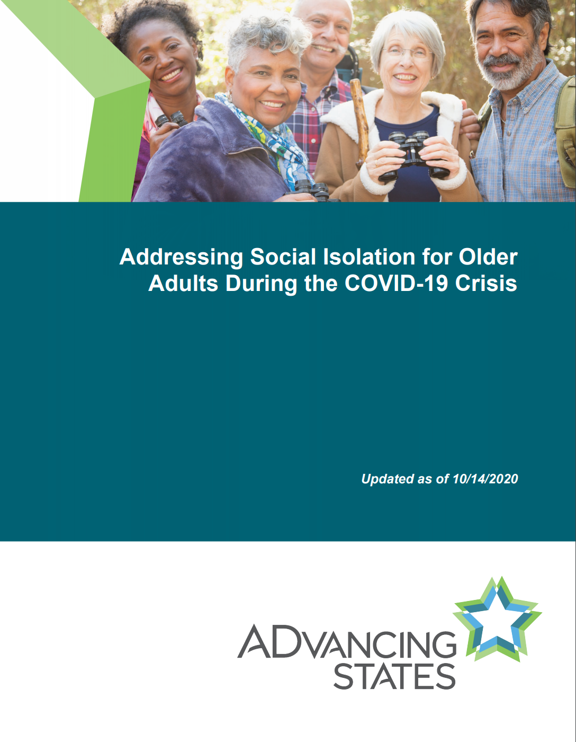
Social Isolation: States and Communities Respond
Resource: Addressing Social Isolation for Older Adults During the COVID-19 Crisis
Compilation of state and community responses to social isolation concerns
http://www.advancingstates.org/initiatives/covid-19-resources/advancing-states-resources
Notes:
Over the past year, we’ve seen states and communities respond in so many ways. For example, there’s been a significant expansion of telephone reassurance programs that provide daily or weekly outreach calls and wellness check-in’s. I mentioned the shift to virtual service delivery and we’re seeing technology used in other ways as well like the provision of animatronic (robotic) pets where there’s a growing body of evidence for their positive impact to older adults. Additionally, agencies at all levels of government are working to mitigate the digital divide. This might involve strategies like subsidizing Internet service, providing tablets (Grandpads), or partnering with state Assistive Technology programs. There is still a ways to go however with improving broadband access. Managed care organizations have also launched initiatives in this area and I know we’re going to hear from Anthem.
Since the pandemic began, ADvancing States has been continuously collecting examples of state responses to social isolation concerns for older adults in the community as well as residential settings. See our resource “Addressing Social Isolation for Older Adults During the COVID-19 Crisis” A great resource for peer learning and sharing.

Slide 13
Social Isolation: National Efforts
Commit to Connect (acl.gov/CommitToConnect)
A new public-private partnership to connect older adults and people with disabilities with services and supports to build social connections
AARP Foundation connect 2 affect
connect2affect.org/
engAGED National Resource Center
engagingolderadults.org/
Notes:
Commit to Connect is a public-private partnership convened by ACL to address the challenge of combatting social isolation during COVID-19 and beyond (ADvancing States is a partner). Activities of this effort include or will include generating public awareness, building a national network of champions to collaborate on solutions and outreach, and developing an online, consumer-focused tool (clearinghouse) that connects people who experience social isolation to customized suggestions for resources. ACL held a technology challenge to advance the clearinghouse and NWD Virginia and United Way Worldwide were the finalists that decided to join forces to develop the tool.
A couple of additional national resources are listed here on the slide, including the AARP Foundation connect 2 affect site which has an assessment and resources and engaged which is the National Resource Center for Engaging Older Adults administered by n4a with resources and best practice examples.

Slide 14
For more information, please visit us at http://www.advancingstates.org/
Notes:
Be sure to visit our COVID-19 website for more state resources including program and policy materials that offer examples and models.

Slide 15
NCI-AD Data and Social Connectedness
A closer look

Slide 16
What is NCI-AD?
A state-driven initiative for state Medicaid, aging, and disability agencies to track the performance and outcomes of their publicly funded LTSS programs
Relatively new – established in 2015
Valid and reliable set of performance indicators across 18 different domains
Information collected directly from older adults and people with physical disabilities
State and national reports posted on www.nciad.org
Notes:
5,603 people surveyed were under 65
6,960 people surveyed were 65 and older
Note on statistical significance – Statically significant differences just means that based on the numbers in each group and how people respond overall, the difference in how the groups respond is likely not due to chance. For that reason we use statistical significance as a starting point, but it’s really up to you to decide what is meaningful/important – where can you have an impact AND what else do we want to know to better understand this experience we’re seeing?

Slide 17
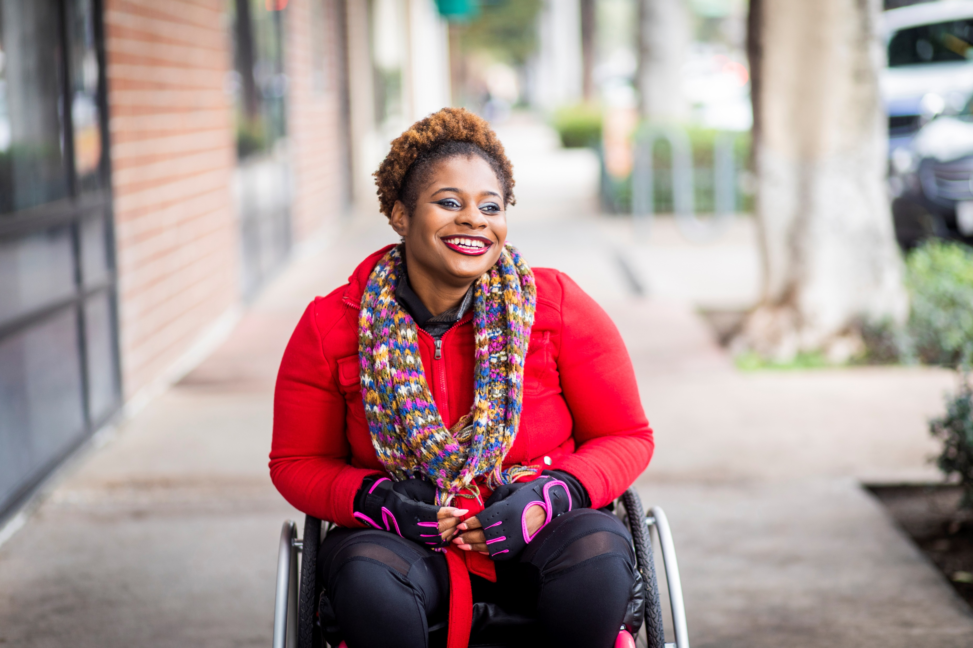
2018-19 NCI-AD National Data: Quick Facts
16 states total
Over 14,000 people surveyed
Older adults (65 and older)
People with physical disabilities (18 and older)
Data collected between June 1, 2018 – May 31, 2019
Surveys conducted face to face

Slide 18
2018-19 NCI-AD National Data: Quick Facts
Average Age 68
7 out of 10 respondents were female
Race and Ethnicity
67% White
21% Black
3% Hispanic
2% Asian
3% Other

Slide 19
14% reported they are often sad or depressed

Slide 20
The 14% of respondents who were often sad or depressed were MORE LIKELY* to …
Have a psychiatric diagnosis
71% often sad
Take medication to feel less sad and depressed
79% often sad
37% not often sad
27% not often sad
Report services and supports did not meet their needs and goals
44% often sad
26% not often sad
Need mental health services (if all needs were not met)
9% often sad
6% not often sad
*More likely than those who were not often sad or depressed;
Statistically significant difference at .01

Slide 21
Respondents under 65 were MORE LIKELY* to often feel sad or depressed
20% of those under 65 often felt sad or depressed
11% of those 65 and older often felt sad or depressed
*Statistically significant difference at .01
Notes:
???

Slide 22
White respondents were MORE LIKELY* to often feel sad or depressed compared to Black respondents
15% of white respondents reported they often felt sad or depressed
13% of black respondents reported they often felt sad or depressed
*Statistically significant difference at .01
Notes:
Black respondents also more likely to live with family (and less likely to live alone!) – in upcoming data spotlight.

Slide 23
The 14% of respondents who were often sad or depressed were LESS LIKELY* to…
Be able to see or talk to friends and family they do not live with when they want
Be as active in their community as they want to be
89% not often sad
79% often sad
9% often sad
20% not often sad
*Statistically significant difference at .01

Slide 24
50% said they were as active in their community as they want to be

Slide 25
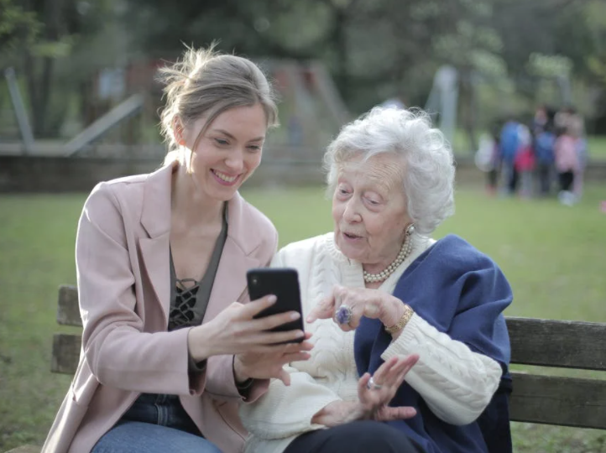
Respondents 65 and older were MORE LIKELY* to report they are as active in their community as they want to be (51%)
42% of those under 65 reported they are as active as they want to be
*Statistically significant difference at .01

Slide 26
White respondents were MORE LIKELY* to report they are as active in their community as they want to be compared to Black respondents
49% of White respondents reported they are as active as they want to be
45% of Black respondents reported they are as active as they want to be
Notes:
White respondents were MORE LIKELY* to report they are as active in their community as they want to be compared to Black respondents 49% of White respondents reported they are as active as they want to be 45% of Black respondents reported they are as active as they want to be

Slide 27
The 50% of respondents who were as active in their community as they want to be were MORE LIKELY* to…
Move around their environment without aids
Report that services and supports meet their needs and goals
Have transportation when they want to do things outside of the home
36% active
83% active
84% active
People who were as active as they want to be were also LESS LIKELY to report they need transportation
6% active
21% not active
33% not active
61% not active
60% not active
* Than people who are not as active as they want to be - Statistically significant difference at .01

Slide 28
The 50% of respondents who were are as active in their community as they want to be were MORE LIKELY* to…
Like how they spend their day
78% as active as wants
43% not as active as wants
Get to do the things they enjoy outside of their home as much as they want to
87% as active as wants
39% not as active as want
* than people who are not as active as they want to be
Statistically significant difference at .01

Slide 29
6 in 10 across states get to do the things they enjoy outside of their home as much as they want to
62% of participants in HCBS programs reported they do the things they enjoy outside of their home as much as they want to
Notes:
Are you able to take part in community activities (like church groups, book clubs, or senior center classes) as much as you want to – either in-person or using video conference technology (like Zoom or Face-time)?
what does community mean now? Has the definition changed due to covid?

Slide 30
Anthem & Social Connectedness
Responding to the need

Slide 31
Questions? Reflections…

Slide 32
Contact Info:
ayoung@advancingstates.org
sgiordano@hsri.org

